Slide 1


Channel Estimation for mmWave Massive MIMO Based Access and Backhaul in Ultra-Dense Network
Zhen Gao, Linglong Dai, and Zhaocheng Wang
Department of Electronic Engineering
Tsinghua University
Beijing 100084, China
2016-5-26
Notes:
Good after everyone, it is my honor to present our recent work titled "Channel Estimation for mmWave Massive MIMO Based Access and Backhaul in Ultra-Dense Network".
As you know, millimeter-wave (mmWave) massive MIMO has been considered as the promising solution to access and backhaul in ultra-dense network (UDN) in future 5G wireless networks. However, the channel estimation for mmWave massive MIMO can be challenging, since we need to acquire the channels associated with hundreds of antennas, and accordingly the pilot overhead can be prohibitively high. In this paper, by exploiting the angle-domain sparsity of mmWave channels, we propose a structured compressive sensing (SCS)-based channel estimation scheme, which is able to achieve accurate channel estimation with significantly reduced pilot overhead.

Slide 2
Contents
1
Technical Background
2
System Model
3
Proposed Scheme
4
Simulation Results
5
Conclusions
Notes:
This presentation consists of the following five parts: … At first, let us briefly look at the technical background.

Slide 3
Technical Background
No. of BS
Bandwidth
Opportunity
[Swindle'14]
  MmWave Massive MIMO
    Larger bandwidth
    Larger antenna gain
    Near-LOS transmission
  Ultral dense network (UDN)
    Denser base stations
    Better frequency reuse
    Reduced link distance
C ≈ D * W * M * log (1+SINR)
Cellular Capacity
No.of Antenna
MmWave massive MIMO and UDN are natually compatible
[Swindle'14] A. L. Swindlehurst, et al., “Millimeter-wave massive MIMO: The next wireless revolution?” IEEE Commun. Mag., Sep. 2014.
Notes:
It is widely expected that future 5G should increase the system capacity by 1000 times. As shown in this figure, massive MIMO, mmwave communications, and ultra dense network are promising technical approaches to realize such aggressive 5G goal. Specifically, mmWave communication can exploit the large unused spectrum resource in mmWave band to improve the system capcity, hundreds of antennas in massive MIMO can provide higher antenna gain to mitigate the severe path loss of mmwave signals. Moreover, UDN can significantly improve the system capacity by employing ultra dense base stations with better frequency resue. In addition, the reduced link distance in UDN is helpful to mitigate the severe path loss of mmwave signals, and the near-light-of-sight transmission in mmWave massive MIMO systems is beneficial to reduce the inter-cell-interferences in UDN. Hence, MmWave, massive MIMO, and UDN are naturally compatible and can be smoothly integrated to achieve the goal of 1000-fold capacity increase.

Slide 4
Technical Background
MmWave Massive MIMO Based UDN
  Low-frequency band
    Control plane
    Larger coverage area
    Control signaling service
  High-frequency (mmWave) band
    Data plane
    Small cell
    Access and backhaul
[Swindle'14] A. L. Swindlehurst, et al., “Millimeter-wave massive MIMO: The next wireless revolution?” IEEE Commun. Mag., Sep. 2014.
Notes:
In this paper, as shown in this figure, we consider the heterogeneous network (HetNet), where the conventional low-frequency band is used for control plane with large coverage but low data rate, while the emerging high-frequency mmWave band is used for data plane with small coverage but high data rate. In such an HetNet, mmWave massive MIMO can be used both for the wireless access in small cells and wireless backhaul between small-cell base stations.

Slide 5
Technical Background
Challenging channel estimation [Ayach’14, Gao’15]
  Hybrid precoding structure
    Reduced RF chains
    Low hardware cost and power consumption
  High pilot overhead
    High-dimensional channels
    Limited observation
[Ayach’14] O. El Ayach, et al., “Spatially sparse precoding in millimeter wave MIMO systems,” IEEE Trans. Wireless Commun., 2014.
[Gao’15] X. Gao, et al., “Energy-efficient hybrid analog and digital precoding for mmwave MIMO systems with large antenna arrays,” IEEE J. Sel. Areas Commun., 2015.
Notes:
On the other hand, to reduce the hardware cost and power consumption, mmWave massive MIMO is likely to adopt the hybrid precoding structure to realize multi-stream or multi-user transmission, where a much smaller number of RF chains than that of BS antennas is used. Such hybrid precoding structure is attractive for implementation. However, it results in the prohibitively high pilot overhead for channel estimation, since the high-dimensional MIMO channels are measured by only a limited number of RF chains.

Slide 6
Technical Background
Overview of existing schemes
  Multilevel codebook-based scheme [Hur’13]
    Limited to single stream transmission
  Reference signal design for channel estimation [Han’14]
    Fail to use sparsity of channels
  Adaptive compressive sensing (CS)-based scheme [Alkhateeb’14]
    Limited to single cell
[S. Hur'13] S. Hur, et al., “Millimeter wave beamforming for wireless backhaul and access in small cell networks,” IEEE Trans. Commun., vol. 61, no. 10, pp. 4391-4403, Oct. 2013
  [S. Han'14] S. Han, et al., “Reference signals design for hybrid analog and digital beamforming,” IEEE Commun. Lett., vol. 18, no. 7, pp. 1191-1193, Jul. 2014.
  [A. Alkhateeb'14] A. Alkhateeb, et al., “Channel estimation and hybrid precoding for millimeter wave cellular systems,” IEEE J. Sel. Topics Signal Process., vol. 8, no. 5, pp. 831-846, Oct. 2014.
Notes:
To date, there have been several channel estimation schemes proposed for mmWave massive MIMO.
Specifically, Hur has proposed a multilevel codebook based joint channel estimation and beamforming, but this scheme is limited to single stream transmission.
Han has proposed the reference signals design for hybrid beamforming, but this scheme fails to exploit the sparsity of channels with considerably performance loss.
Recently, an adaptive compressive sernsing based channel estiamtion scheme is proposed, where the sparsity of channels is used, but this scheme is limited to single cell scenario. To this end, we propose a structured compressive sensing (SCS)-based channel estimation scheme, where the channels associated with multiple small cells can be simultaneously acquired with much reduced pilot overhead.

Slide 7
Contents
1
Technical Background
2
System Model
3
Proposed Scheme
4
Simulation Results
5
Conclusions
Notes:
In the second part, the mmWave massive MIMO channel model will be introduced.

Slide 8
System Model
  MmWave massive MIMO channel model [Hur’13]
  Delay-domain mmWave MIMO channels
  Frequency-domain mmWave MIMO channels
AoD
AoA
Delay
Gain
FFT size of OFDM symbol
Sampling rate
[S. Hur'13] S. Hur, et al., “Millimeter wave beamforming for wireless backhaul and access in small cell networks,” IEEE Trans. Commun., vol. 61, no. 10, pp. 4391-4403, Oct. 2013
Notes:
Specifically, the delay-domain mmWave massive MIMO channel can be modeled as (1),
where ...
Moreover, due to the large system bandwidth and different path delays, mmWave MIMO channels appear the frequency selective fading. If we consider OFDM to comat the frequency selective fading channels, the frequency-domain mmWave MIMO channels can be expressed in the following equations (2)
where ...

Slide 9
System Model
Sparsity of mWave massive MIMO channels
  Frequency-domain mmWave MIMO channels
  Angle-domain mmWave MIMO channels
FFT size of OFDM
Sampling rate
Sparse
matrix
Rx DFT matrix
Tx DFT matrix
Sparse vector
[A. Alkhateeb'14] A. Alkhateeb, et al., “Channel estimation and hybrid precoding for millimeter wave cellular systems,” IEEE J. Sel. Topics Signal Process., vol. 8, no. 5, pp. 831-846, Oct. 2014.
Notes:
Additionally, for mmWave communications, the path loss for NLOS paths is much larger than that for LOS paths in mmWave, which indiates that the mmWave MIMO channels appear the obviously sparsity in the angular domain. To be specific, the angle-domain mmWave channels can be acuqired by this equation, where Ar and At are unitary matrices. For the 64x64 mmWave MIMO with three paths, the energy distribution of the angle-domain MIMO channel is illustrated in the right figure, where the sparsity of mmWave MIMO channels is clear.

Slide 10
System Model
Sparsity of mWave massive MIMO channels
  Angle-domain sparse mmWave MIMO channels
  Structured sparsity over bandwidth
Sparse vector
[A. Alkhateeb'14] A. Alkhateeb, et al., “Channel estimation and hybrid precoding for millimeter wave cellular systems,” IEEE J. Sel. Topics Signal Process., vol. 8, no. 5, pp. 831-846, Oct. 2014.
Notes:
By vectorzing the angle-domain mmWave MIMO channel matrix, we further acquire the sparse channel vector h_p^f (1) and only the minority of elements in such channel vecotr occupy the majoriity of channel energy, which can be expressed in this equation (2).
It should be noted that accoding to the relationship between the frequency-domain channel and angle-domain channel, we find that the frequency-domain mmWave MIMO channels model share the same AoA and AoD but different channel gains over different subcarriers. Hence the angled-domain mmWave chanels share the very similar sparsity overh the bandwidth or different subcarriers, which can be expressed in this equation (4).

Slide 11
Contents
1
Technical Background
2
Sysmtem Model
3
Proposed Scheme
4
Simulation Results
5
Conclusions
Notes:
In the third part, we will propose the SCS-based channel estimation scheme for access in UDN, which can be also used to estimate the channels for backhaul.

Slide 12
Proposed Scheme
Channel estimation for mmWave MIMO Based UDN
  Challenge
    Inter-cell-interence
  Target
    Estimate channels of multiple small-cell BSs nearby
  Task
    Pilot design at M small-cell BSs
    Channel estimator at user side
Notes:
Regarding the channel estimation for mmWave massive MIMO based UDN, the most challenging problem is inter-cell-interence, since each user may recieve the pilot signals from different BSs in the phase of channel estimation. Hence, how to reliabley estimate the channels of multiple small-cell BSs nearby at the user is important. This motivates to eloborate the pilot design at multiple small-cell BSs and the channel estimator at each user.

Slide 13
Proposed Scheme
Pilot training
: received p-th pilot signal in t-th time slot
: analog combining matrix
: digital combining matrix
: frequency-domain channel associated with m-BS
: transmit p-th pilot signal
: analog precoding matrix
: digital precoding matrix
: AWGN
Notes:
Specifically, the received p-th pilot signal in the t-th time slot can be expressed in this equation, where OFDM is considered. Pilots are the same? Precoding are the same?

Slide 14
Proposed Scheme
Pilot training
  Received p-th pilot signal in the t-th time slot
Notes:
Furthermore, the recieved pilot signal can be simplified as this equation.

Slide 15
Proposed Scheme
Pilot training
  Received p-th pilot signal in the t-th time slot
  Aggregate received pilot signal in G time slots
Notes:
Besides, due to the quasi-static property of the channel within the coherence time, the received signals in G successive time slots can be jointly exploited to acquire the
downlink channel estimation at the user, which can be expressed as.

Slide 16
Proposed Scheme
Pilot training
  Received p-th pilot signal in the t-th time slot
  Aggregate received pilot signal in G time slots
Sparsity
CS theory can reconstruct high-dimensional signal
from its low-dimensional measurements
Notes:
To accurately estimate the channel from this quation, the value of G used in conventional algorithms can be very large. On the other hand, mmWave channel $h$ exhibit sparsity, which motivates us to exploit CS to reconstruct high-dimensional sparse mmWave channels with much reduced training overhead.

Slide 17
Proposed Scheme
Structured compressive sensing (SCS)-based channel estimation
  Channel estimation by solving optimaization problem
s.t.
Challenges：
  SCS-based non-orthogonal pilot design
  SCS-based channel estimator
Notes:
To be specific, the channel estimation can be acquired by solving this optimaization problem. where two challenges should be well addressed: the first challenge is how to design the SCS-based pilot for reduced training overhead; the second challenge is how to design the channel estimator under the framework of SCS theory for relaible channel estimation performance.

Slide 18
Proposed Scheme
SCS-based non-orthogonal pilot design
  How to design pilot signal
Problem 1.
Theorem 1. For , whose elements obey an i.i.d. continuous distribution, there exist full rank matrices for 2≤ p ≤P satisfying if we select as the bridge, is the common support set. Consequently, x_{p} for 1≤ p ≤P will be the unique solution of problem 1 if
where
Diverifying pilot signal of different subcarriers for diversity gain
Notes:
For the first challenge, we extract our channel estimation problem as the pure CS problem and we further propose theorem 1, which enlightens us to diverify the pilot signal of different subcarriers for diversity gain.

Slide 19
Proposed Scheme
SCS-based non-orthogonal pilot design
  Pilot signal
  Pilot pattern arrangement
Notes:
To be specific, we adopt the mutually indendent and random pilot signal with constant envelope, and the piloit signal from different subcarriers are also mutually independent according to theorem 1. Moreover, regarding the pilot pattern arrangement, for the conventional orthogonal pilot as shown the left figure, pilot from different transmit antennas occupy different time-frequency element, while the proposed the non-orthogonal pilot allow the pilot of different antennas
occupy the identically same time-frequency element, which can reduce the pilot overhead considerably.

Slide 20
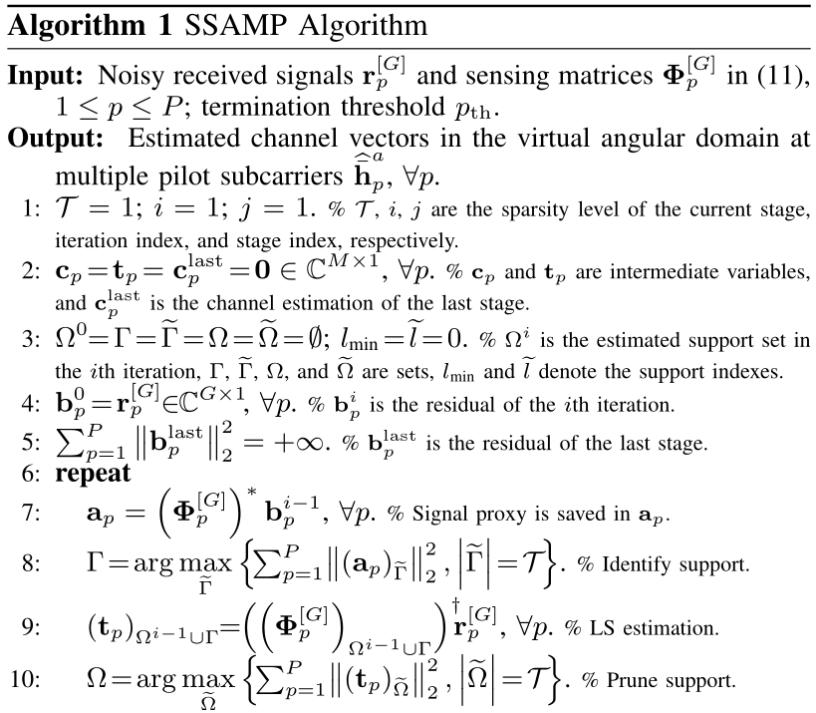
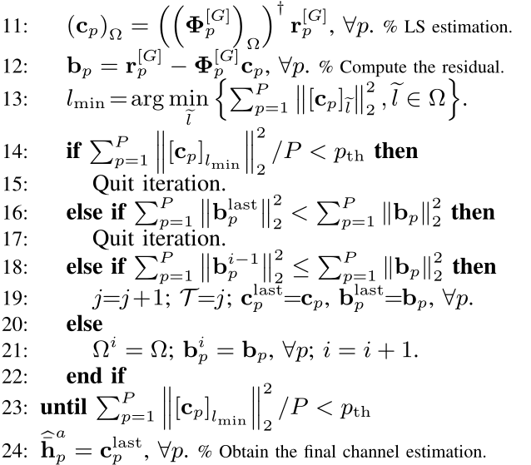
Proposed Scheme
SCS-based channel estimator
  Sturcutred sparsity adaptive matching pursuit (SSAMP) algorithm
Notes:
Furthermore, we propose the Sturcutred sparsity adaptive matching pursuit algorithm, which can reliable reconstruct high-dimensional mmWave sparse channels from its much reduced low-dimenional observations.
Compared to the conventional CS algoriothms, the proposed algorithm can joint estiamte the channels of multiple subcarriers by exploiting the structured sparsity of mmWave channels over different subcarriers.

Slide 21
Proposed Scheme
SCS-based channel estimator
  Sturcutred sparsity adaptive matching pursuit (SSAMP) algorithm
Notes:
Moreover, we also propose a iteration stopping criteration, which can acquire the channel sparsity level accurately.

Slide 22
Contents
1
Technical Background
2
Sysmtem Model
3
Proposed Scheme
4
Simulation Results
5
Conclusions
Notes:
In the fourth part, we provide the simualtion results to investigate the proposed scheme.

Slide 23

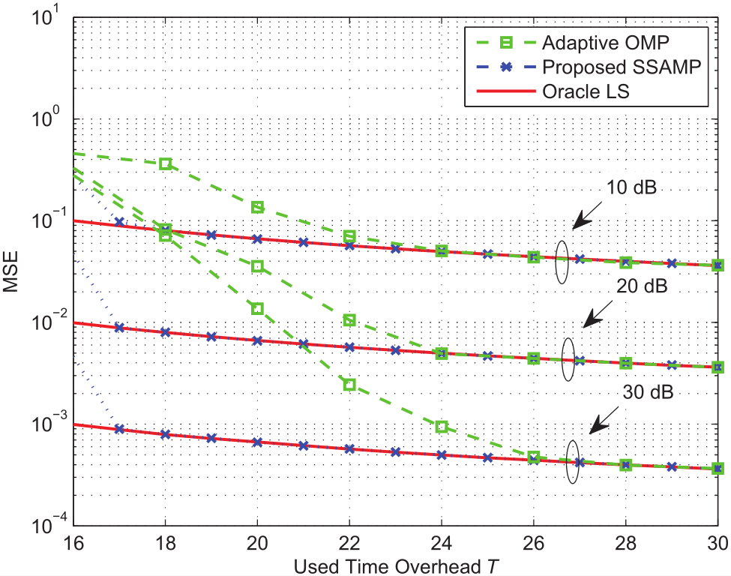
Simulation Results
Simulation parameters and results
Carrier frequency:
Bandwidth:
No. BS antenna:
No. BS RF:
No. user antenna:
No. user RF:
No. multipath:
Max delay spread:
No. pilot:
Notes:
we compares the MSE performance of the adaptive OMP scheme and the SSAMP algorithm. The oracle LS estimator with the known support set of the sparse channel vectors was adopted as the performance bound. From Fig. 4, it can be seen that the adaptive OMP scheme performs poorly. By contrast, the SSAMP algorithm is capable of approaching the oracle LS performance bound. This is because the proposed SCS-based scheme fully exploits the spatially common sparsity of
mmWave channels within the system bandwidth.

Slide 24
Contents
1
Technical Background
2
Sysmtem Model
3
Proposed Scheme
4
Simulation Results
5
Conclusions
Notes:
Finally, we will conclude this paper.

Slide 25
Conclusions
Propose SCS-based channel estimation scheme for the mmWave massive MIMO based access and backhaul in UDN
We provide Theorem 1 and the associated proof, which enlightens us to design non-orthogonal pilot at the transmitter by exploiting the sparsity of mmWave channels in the angular domain
At the receiver, the proposed structured sparsity adaptive matching pursuit (SSAMP) algorithm can simultaneously estimate the channels associated with multiple small-cell BSs
Simulations confirm the good performance of the proposed scheme
Notes:
In this paper, we have proposed the SCS-based channel estimation scheme for the mmWave massive MIMO based access and backhaul in UDN.
By exploiting the sparsity of mmWave channels in the angular domain due to the high path loss for NLOS paths in mmWave, we propose the non-orthogonal pilot at the transmitter and the SCS-based channel estimator at the receiver. The proposed scheme can simultaneously estimate the channels associated with multiple small-cell BSs, and the required pilot overhead is only dependent on the small number of the dominated multipath. Simulation results have confirmed that our scheme can reliably acquire the mmWave massive MIMO channels with much reduced pilot overhead.

Slide 26

Thank you !

